Slide 1

Faculty of computer science.
Modern Methods of Data Analysis
Customer Personality analysis
Dataset Link
by: Anwar Ibrahim and Fares Ghazzawi
Moscow, 2021

Slide 2

Faculty of computer science.
Overview
Introduction and problem statement
Data Summary and basic statistics
Methodology
Experiments

Slide 3
Faculty of computer science-introduction.
Introduction and problem statement
Customer Personality Analysis is a detailed analysis of a company’s ideal customers.
Customer personality analysis helps a business to modify its product based on its target customers from different types of customer segments.
For example, instead of spending money to market a new product to every customer in the company’s database, a company can analyze which customer segment is most likely to buy the product and then market the product only on that particular segment.

Slide 4
Faculty of computer science-Proposed method.
Data Summary and basic statistics
Customer information
Products(amount spent on different products in last 2 years)
Promotion
Place
ID
Year_Birth
Education
Marital_Status
Income
Kidhome
Teenhome
Dt_Customer
Recency
Complain
MntWines
MntFruites
MntMeatProducts
MntFishProducts
MntSweetProducts
MntGoldProds
NumDealsPurchases
AcceptedCmp1
AcceptedCmp2
AcceptedCmp3
AcceptedCmp4
AcceptedCmp5
Response
NumWebPurchases
NumCatalogPurchases
NumWebVisitsMonth
NumStorePurchases
The given dataset has 2240 objects and 29 attributes.

Slide 5
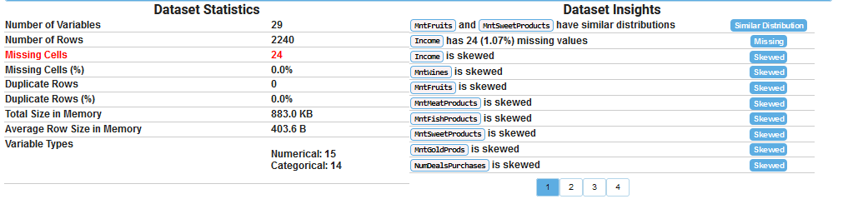
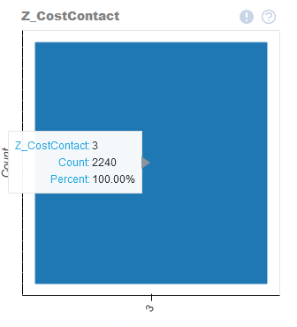
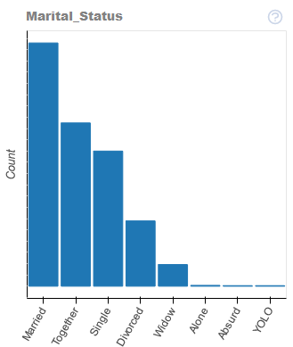
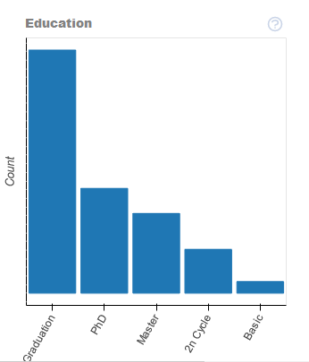
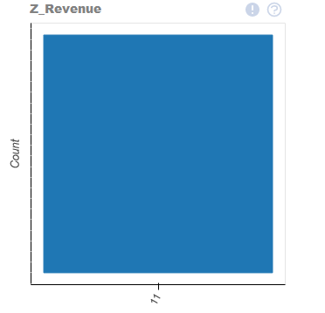
Faculty of computer science-Proposed method.
Data Summary and basic statistics

Slide 6
Faculty of computer science-Proposed method.
Methodology
K- mean
we are trying to find groups “clusters”, which haven’t been explicitly labeled in the data, and it is the least complex method.
Hierarchal
it allows us to build tree structures depending on the similarities between data,

Slide 7
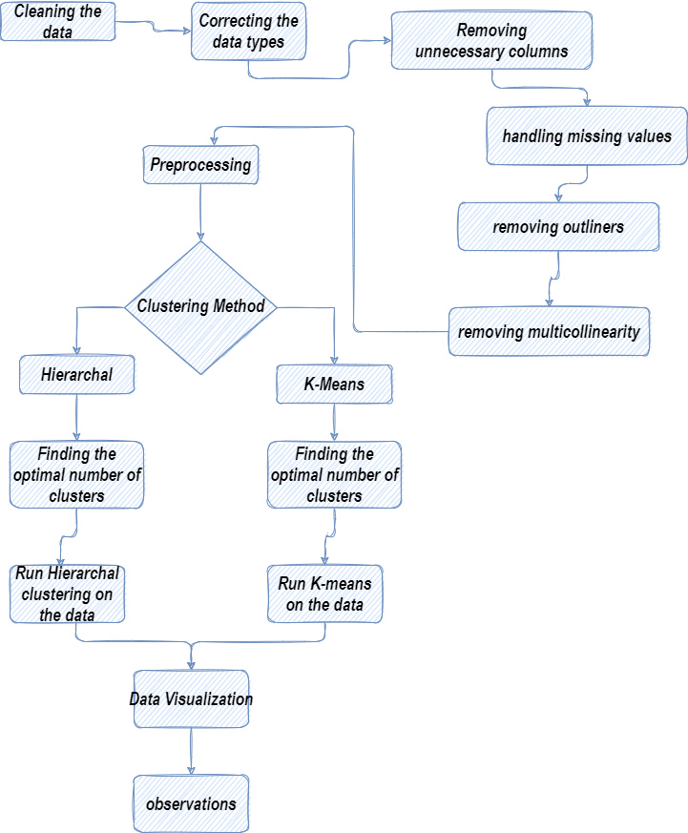
Faculty of computer science-Proposed method.
Experiments

Slide 8
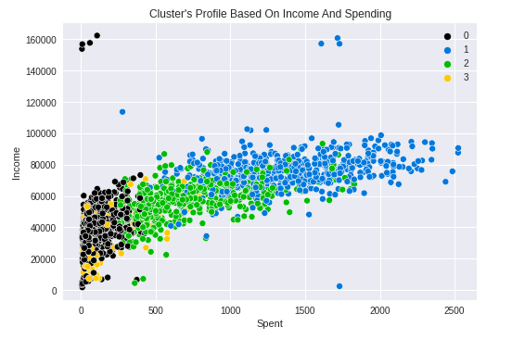
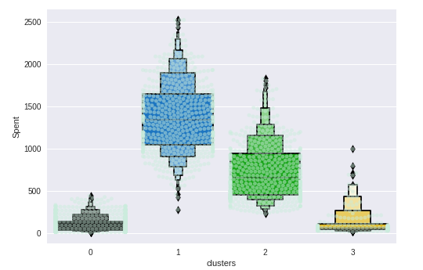
Faculty of computer science-Proposed method.
Results

Slide 9
Faculty of computer science-Proposed method.
Results
Cluster 1
Cluster 2
Cluster 3
Cluster 4
Has the least number of objects. “154”
Has the greatest number of objects. “897”
Has 459 objects in it.
Has 703 objects in it.
They spend the least.
All of them are undergraduates.
They are the youngest.
Most of them have no kids
Has only postgraduates.
Don’t spend a lot.
Most of the customers in it have either no kids or two kids.
Most of the customers in this cluster have either one kid or no kids.
They spend the most out of all the clusters.
Most of them are postgraduates.
The most active people.
Has both undergraduates and postgraduates.
Most of them have one kid.
Most of them spend moderately.

